Slide 1
Laboratory Presentation
EMBEDDED REAL-TIME CONTROL
ERTC-LAB
2022-2023

Slide 2
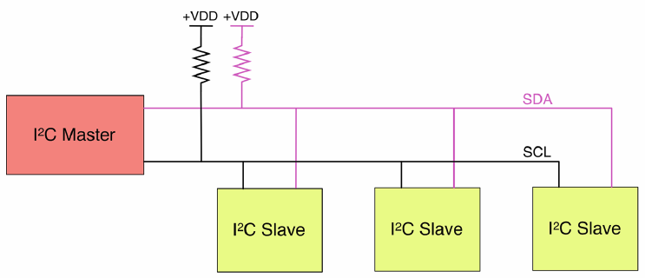
LAB 1 – I2C

Slide 3
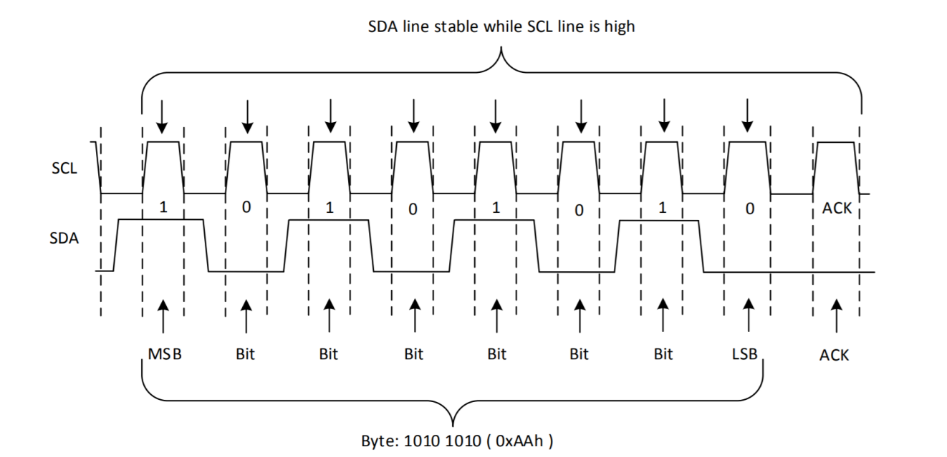
LAB 1 – I2C

Slide 4
LAB 1 – Interrupt Callback
...
Same for row

Slide 5
LAB 1 – Keypad Input
...
...

Slide 6
LAB 1 – Line Sensor
...

Slide 7
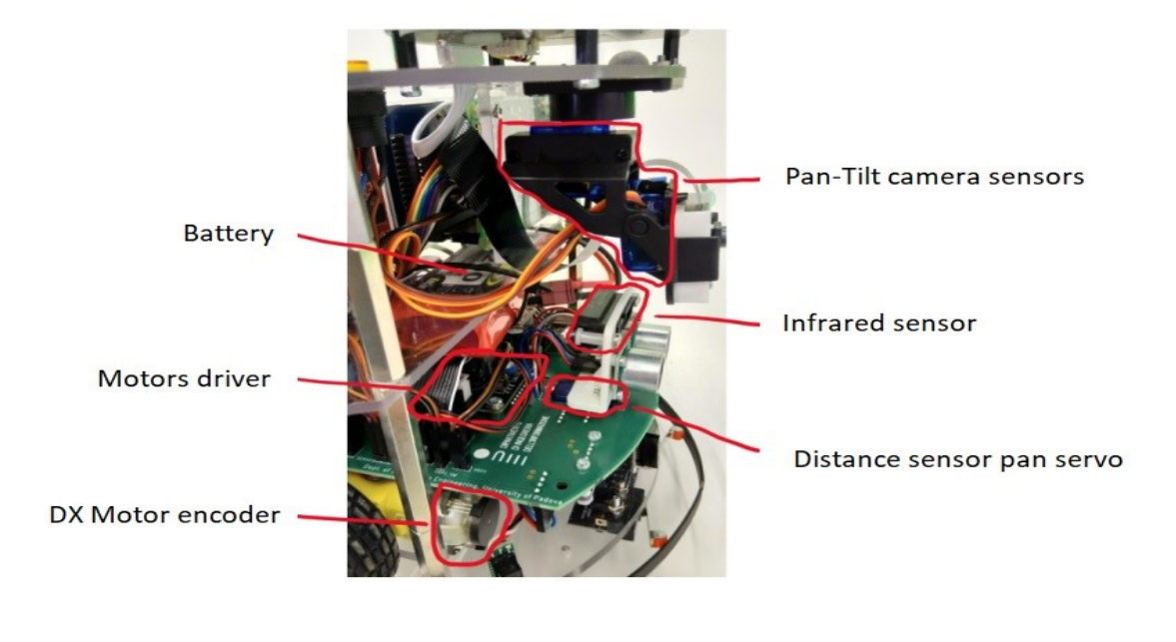
LAB 2 - Goal
Open loop control (camera stabilizer)

Slide 8
LAB 2 - Description
IMU
Accelerometer
Gyroscope
Magnetometer
Servo Motor
DC Motor
Gear Train
Position Feedback Sensor
Control Circuitry
(PWM)

Slide 9
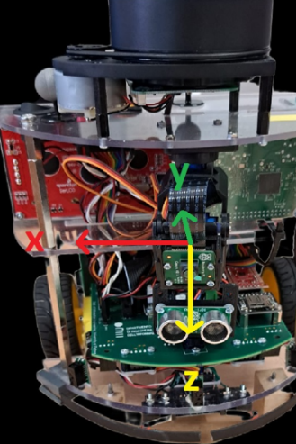
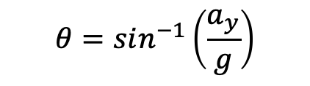
LAB2 - Description
Tilt refers to the vertical movement of the camera, where the camera is moved up or down.
Pan refers to the horizontal movement of the camera, where the camera is rotated around its vertical axis to the left or right.
$$θ=sin^{−1}\left(\frac{a_{y}}{g}\right)$$

Slide 10
LAB 2 - Exercises
Exercise 1

Slide 11
LAB 2 - Exercises
Exercise 2

Slide 12
LAB 2 - Exercises
DataLog structure
Matlab Data Logger :

Slide 13
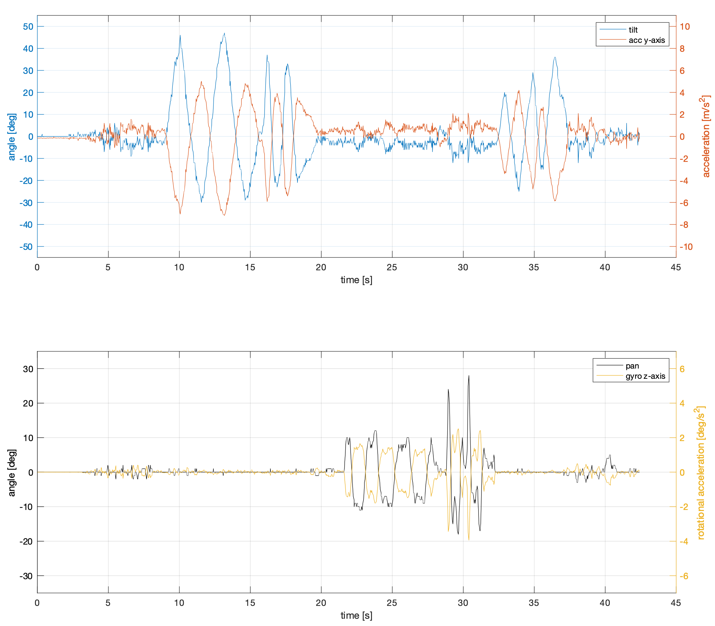
LAB 2 - Result

Slide 14
LAB 3 - Goal
Design and implement a PI controller to drive the DC motors
design a PI controller, fed by the angular speed of the wheel, measured in rotations per minute [rpm], as the reference signal.

Slide 15
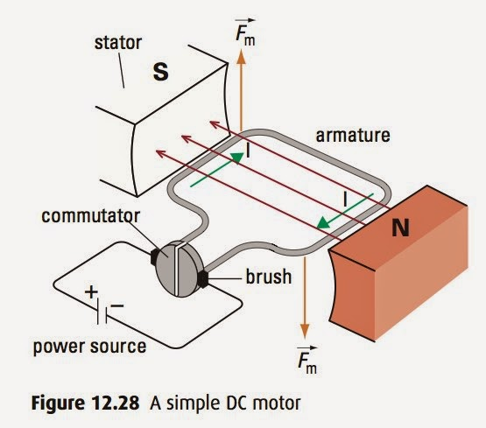
LAB 3 – DC Motor
DC electrical energy
Mechanical energy​
Components:
Stator
Rotor
Commutator
Brushes

Slide 16
LAB 3 – DRV8871
PWM input
Proper output (Voltage / Current)
Forward and Brake
Modes
Forward and Coast
The motor can be controlled bidirectionally by implementing an H-bridge
Coast mode allows the motor to coast to a stop, which means that the motor is not driven and will move by inertia. On the other hand, Brake mode will stop the motor faster
!

Slide 17
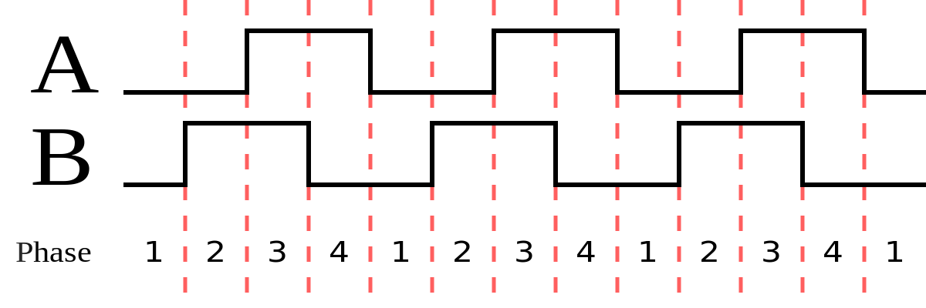
LAB 3 – Position Encoder
Position information
Electrical signal
quadrature encoder with B leading over A:

Slide 18
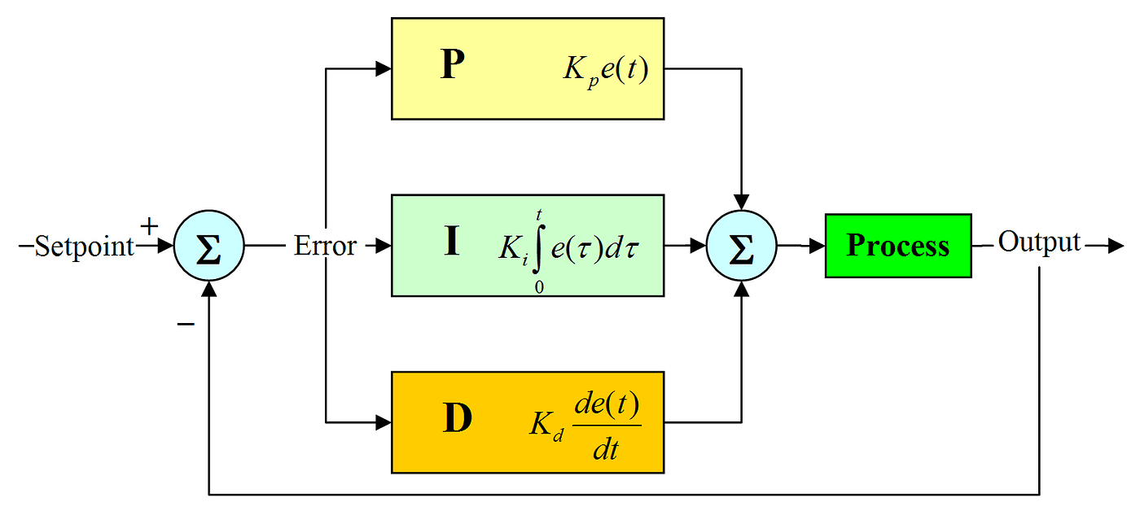

LAB 3 – PID Controller
Why not DERIVATIVE ?

Slide 19

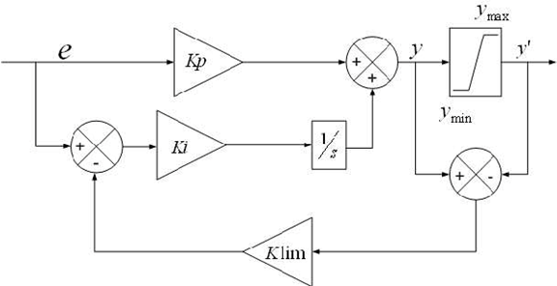
LAB 3 – Anti-Windup
large change in setpoint
integral term accumulates a significant error
overshoot
How to solve it?
Saturation

Slide 20
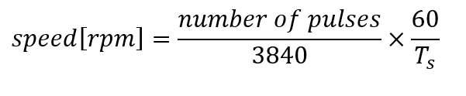
LAB 3 – Exercises
Calculating the speed of the motors in rpm:
PI Controller:​

Slide 21
LAB 3 – Exercises
Calculating the duty cycle:​

Slide 22
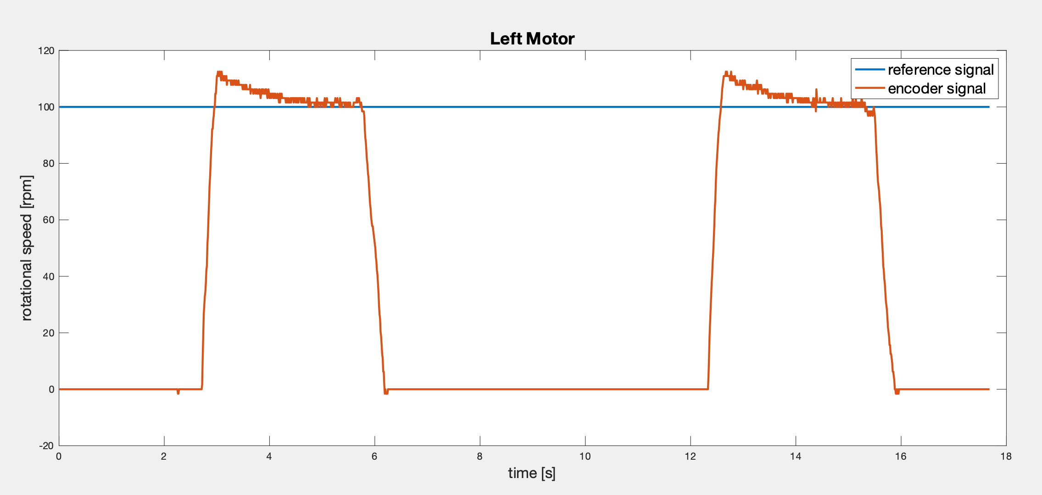
LAB 3 – Exercises
Results:​
Forward/Brake technique with Anti-Windup feature:

Slide 23
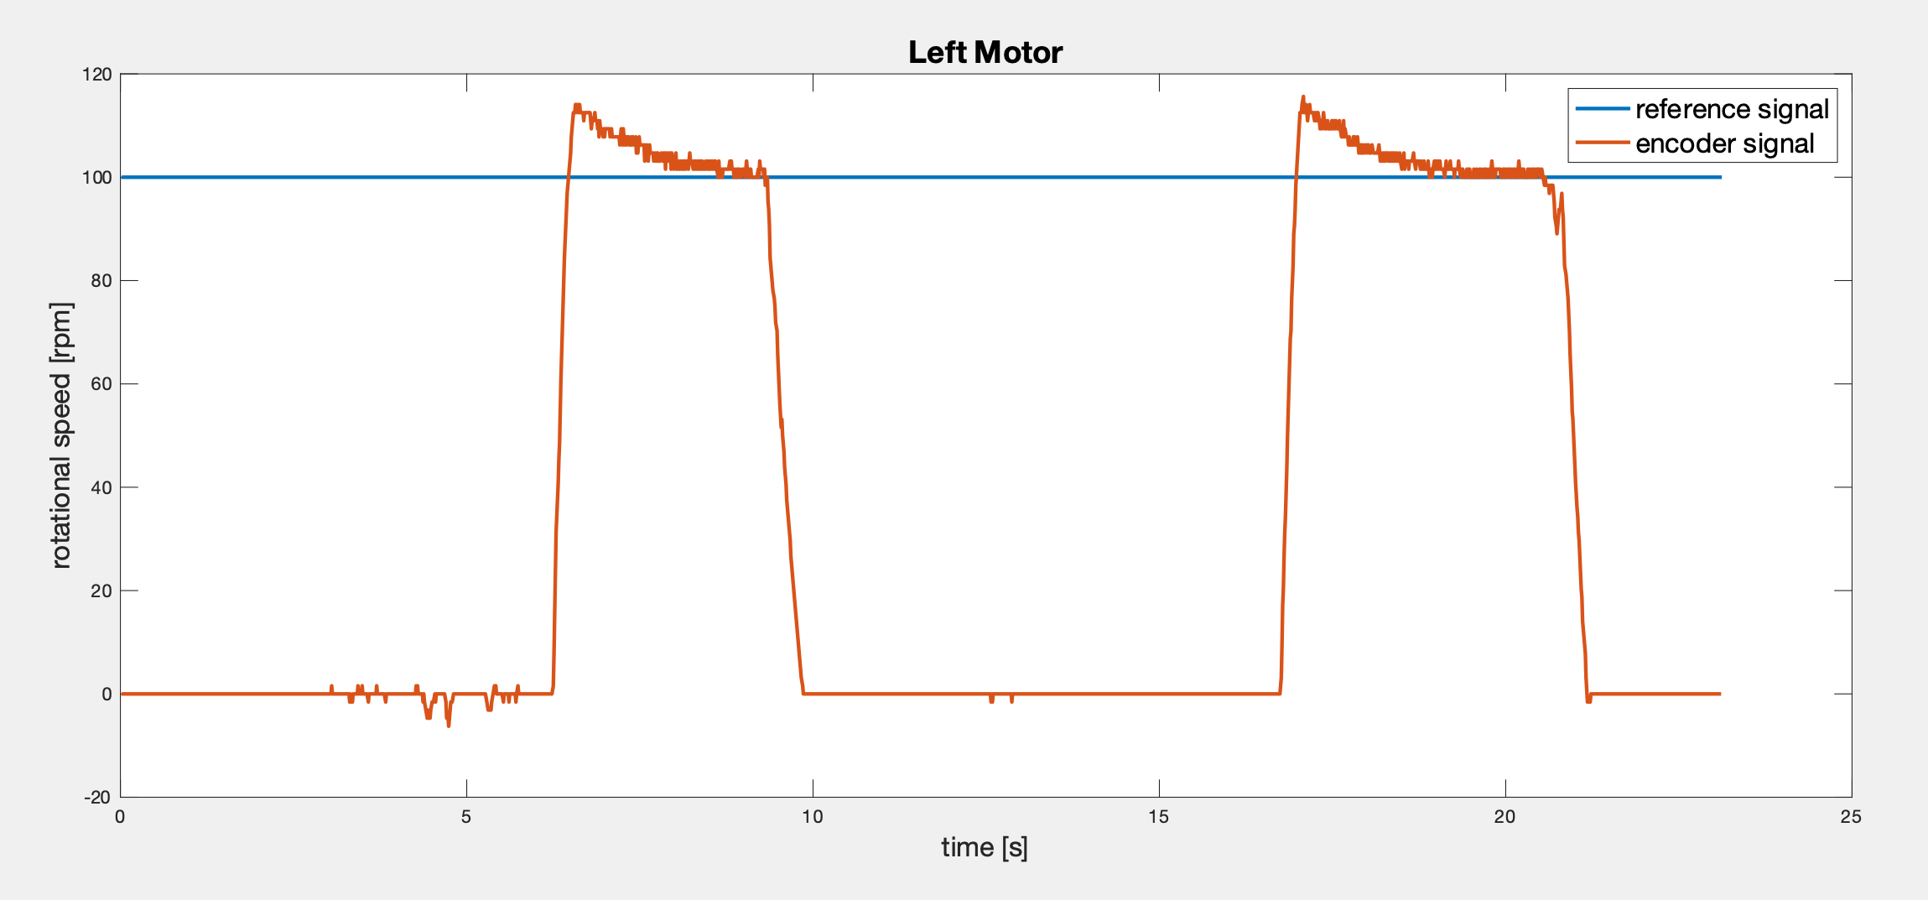
LAB 3 – Exercises
Results:​
Forward/Coast technique with Anti-Windup feature:

Slide 24
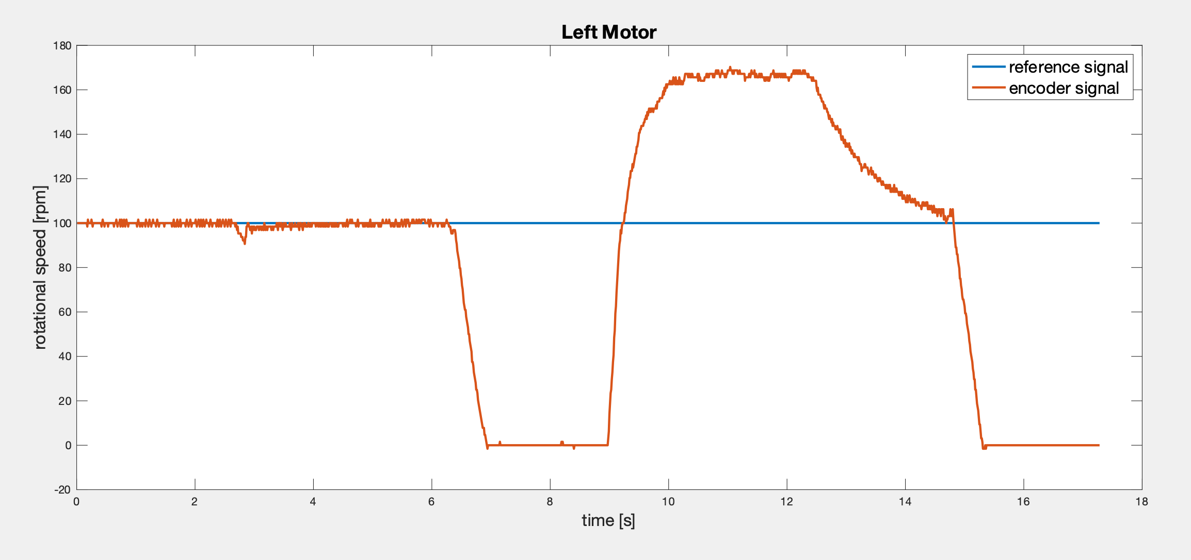
LAB 3 – Exercises
Wrong Anti-Windup!!!
Results:​
Forward/Brake technique without Anti-Windup feature:

Slide 25
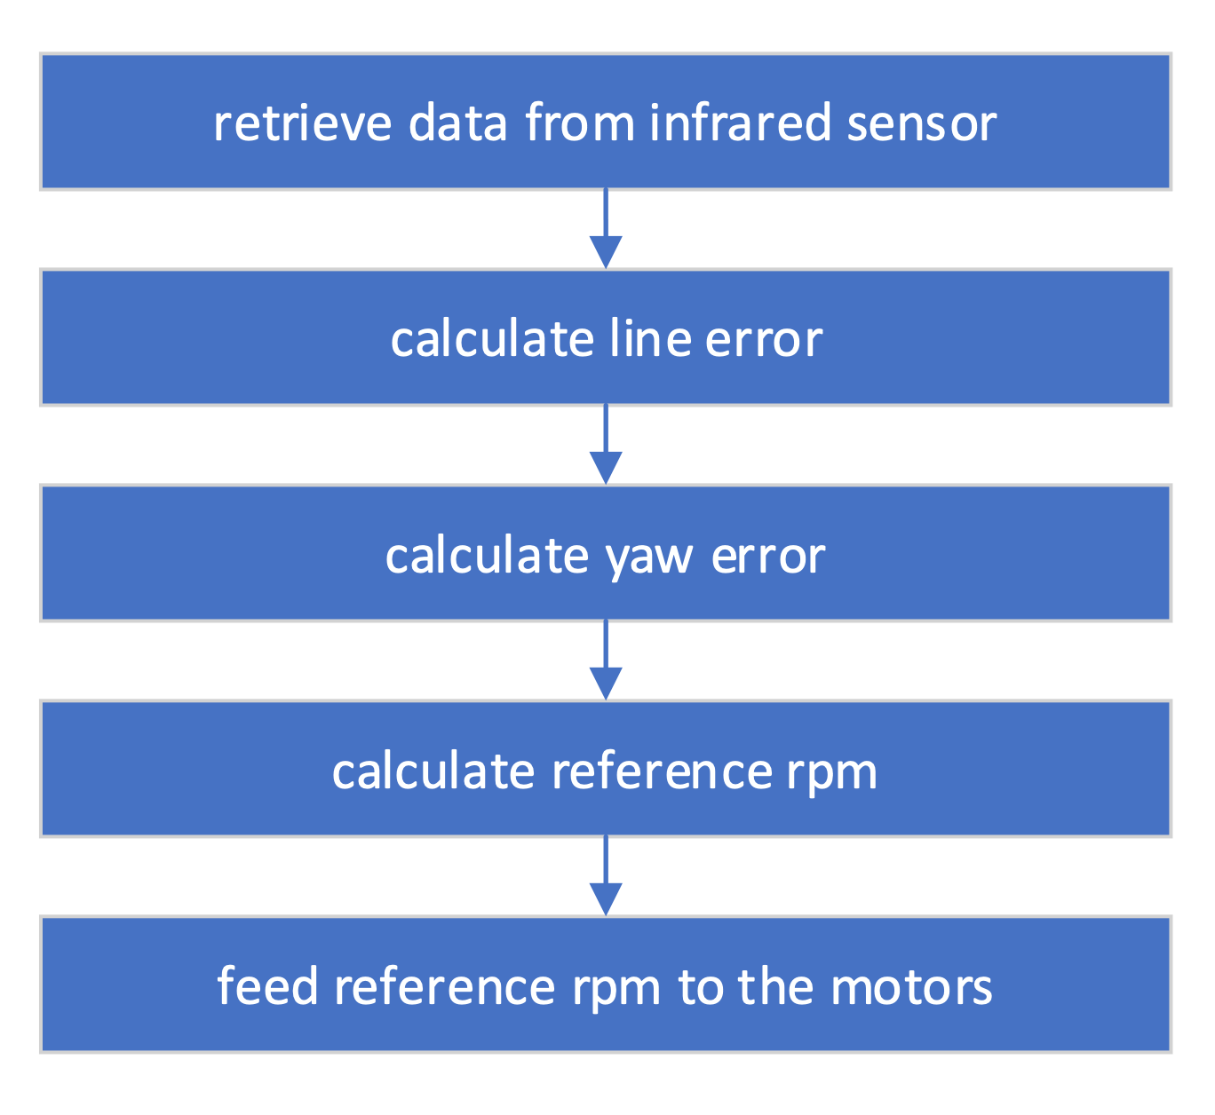
LAB 4 - Goal
Goal: Line following robot
Notes:
Goal:
Combine line sensor – motors
Code works following scheme
Retrieve data infrared
Calc error
Closed loop feedback system
→ Data retrieved is calculated in an array

Slide 26
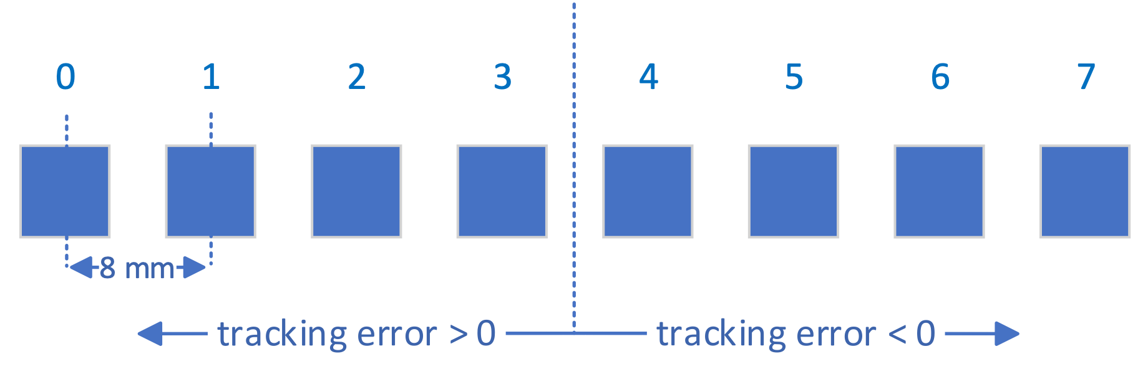
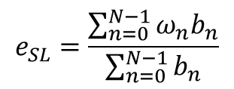
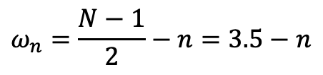
LAB 4 – Infrared Sensor
$$e_{SL}=\frac{\sum_{n=0}^{N−1}{ω_{n}b_{n}}}{\sum_{n=0}^{N−1}{b_{n}}}$$
sum of distances
sum of activated sensors
$$ω_{n}=\frac{N−1}{2}−n=3.5−n$$
distance of each sensors from middle
Notes:
Line sensor consists of 8 infrared diodes
8 mm apart
Goal is to keep the line in the middle
Introduced tracking error: eSL
→ To Improve system

Slide 27
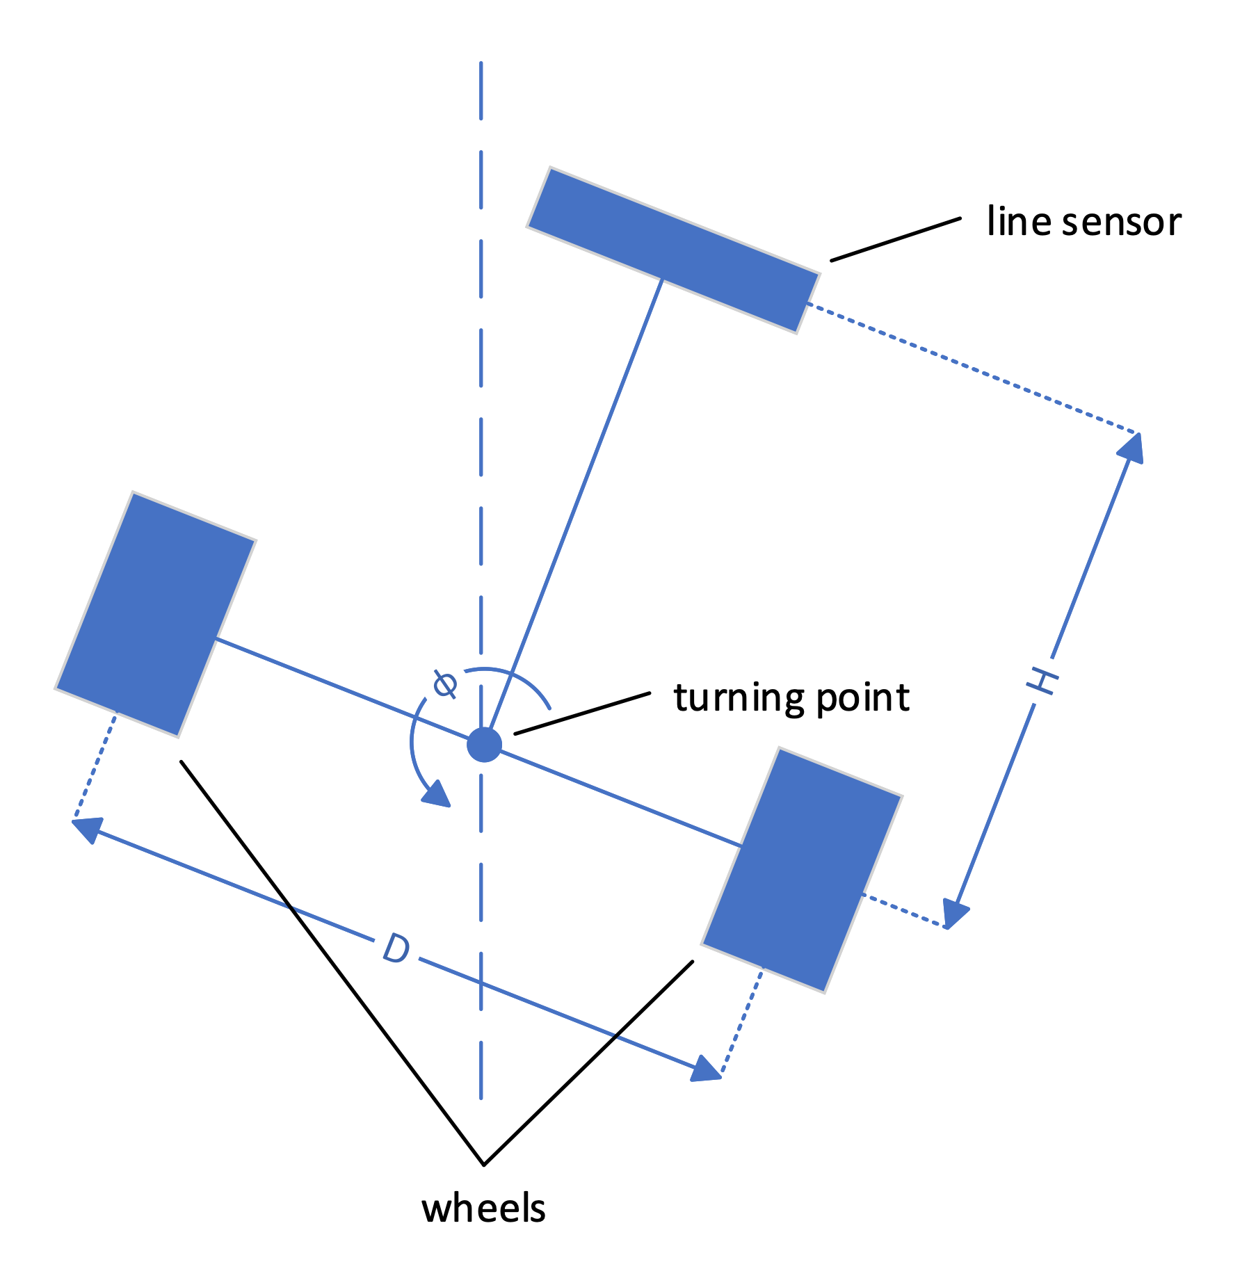

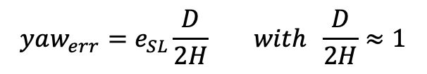
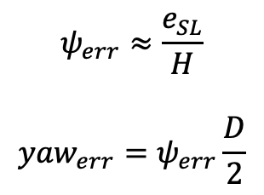
LAB 4 - Tracking Error
$$ψ_{err}≈\frac{e_{SL}}{H}$$
$$yaw_{err}=ψ_{err}\frac{D}{2}$$
$$yaw_{err}=e_{SL}\frac{D}{2H} with \frac{D}{2H}≈1$$
$$yaw_{err}≈e_{SL}$$
D = 0.165m
H = 0.085m
Notes:
Takes into consideration the geometry of Robot
Turning point
in theory - more precise error rate
But D/2*H = 1
Yaw_err = eSL
psi
→ with tracking error compute reference rpm

Slide 28
LAB 4 – Calculate Reference
reference_rpm_L = 100 - yaw_err*12; //jerky on straight
reference_rpm_R = 100 + yaw_err*12;
reference_rpm_L = 100 - yaw_err*gain;
reference_rpm_R = 100 + yaw_err*gain;
if(ABS(yaw_err)<2)
gain = 2;
if(ABS(yaw_err)<4)
gain = 4;
...
reference_rpm_L = 100 - yaw_err*ABS(yaw_err); //very good
reference_rpm_R = 100 + yaw_err*ABS(yaw_err);
Notes:
Reference rpm
Base speed + error * gain
1. result
Fast and reliable
2. result
Fast, reliable and smooth, but complicated to tune
3. Result
Fast, reliable, smooth, simple
→ Show result in action

Slide 29
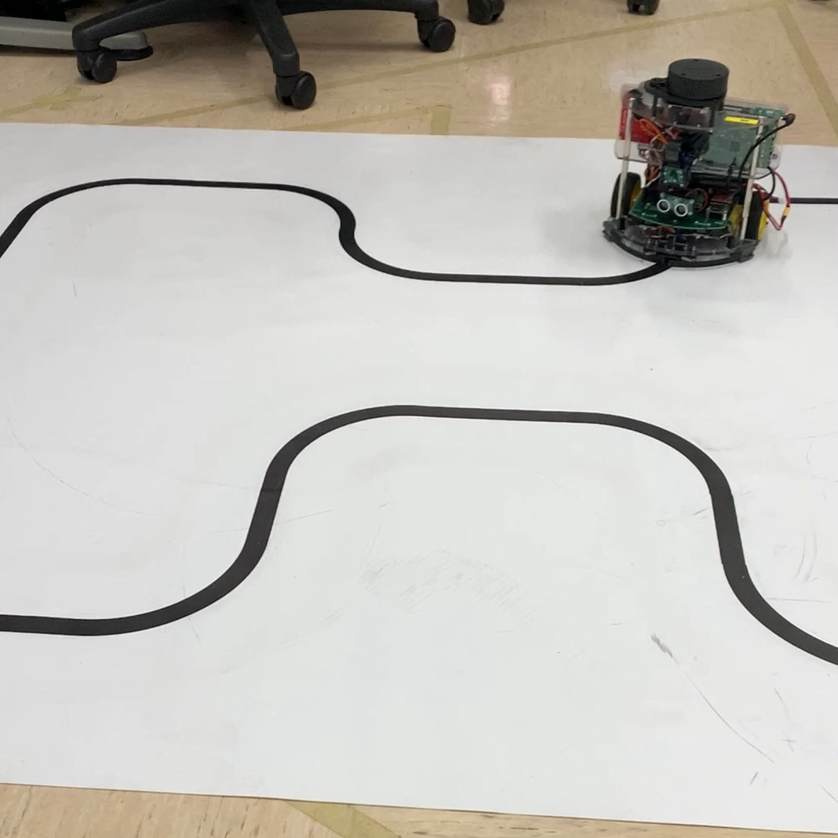
LAB4 - Results
Notes:
→ Show graphs

Slide 30
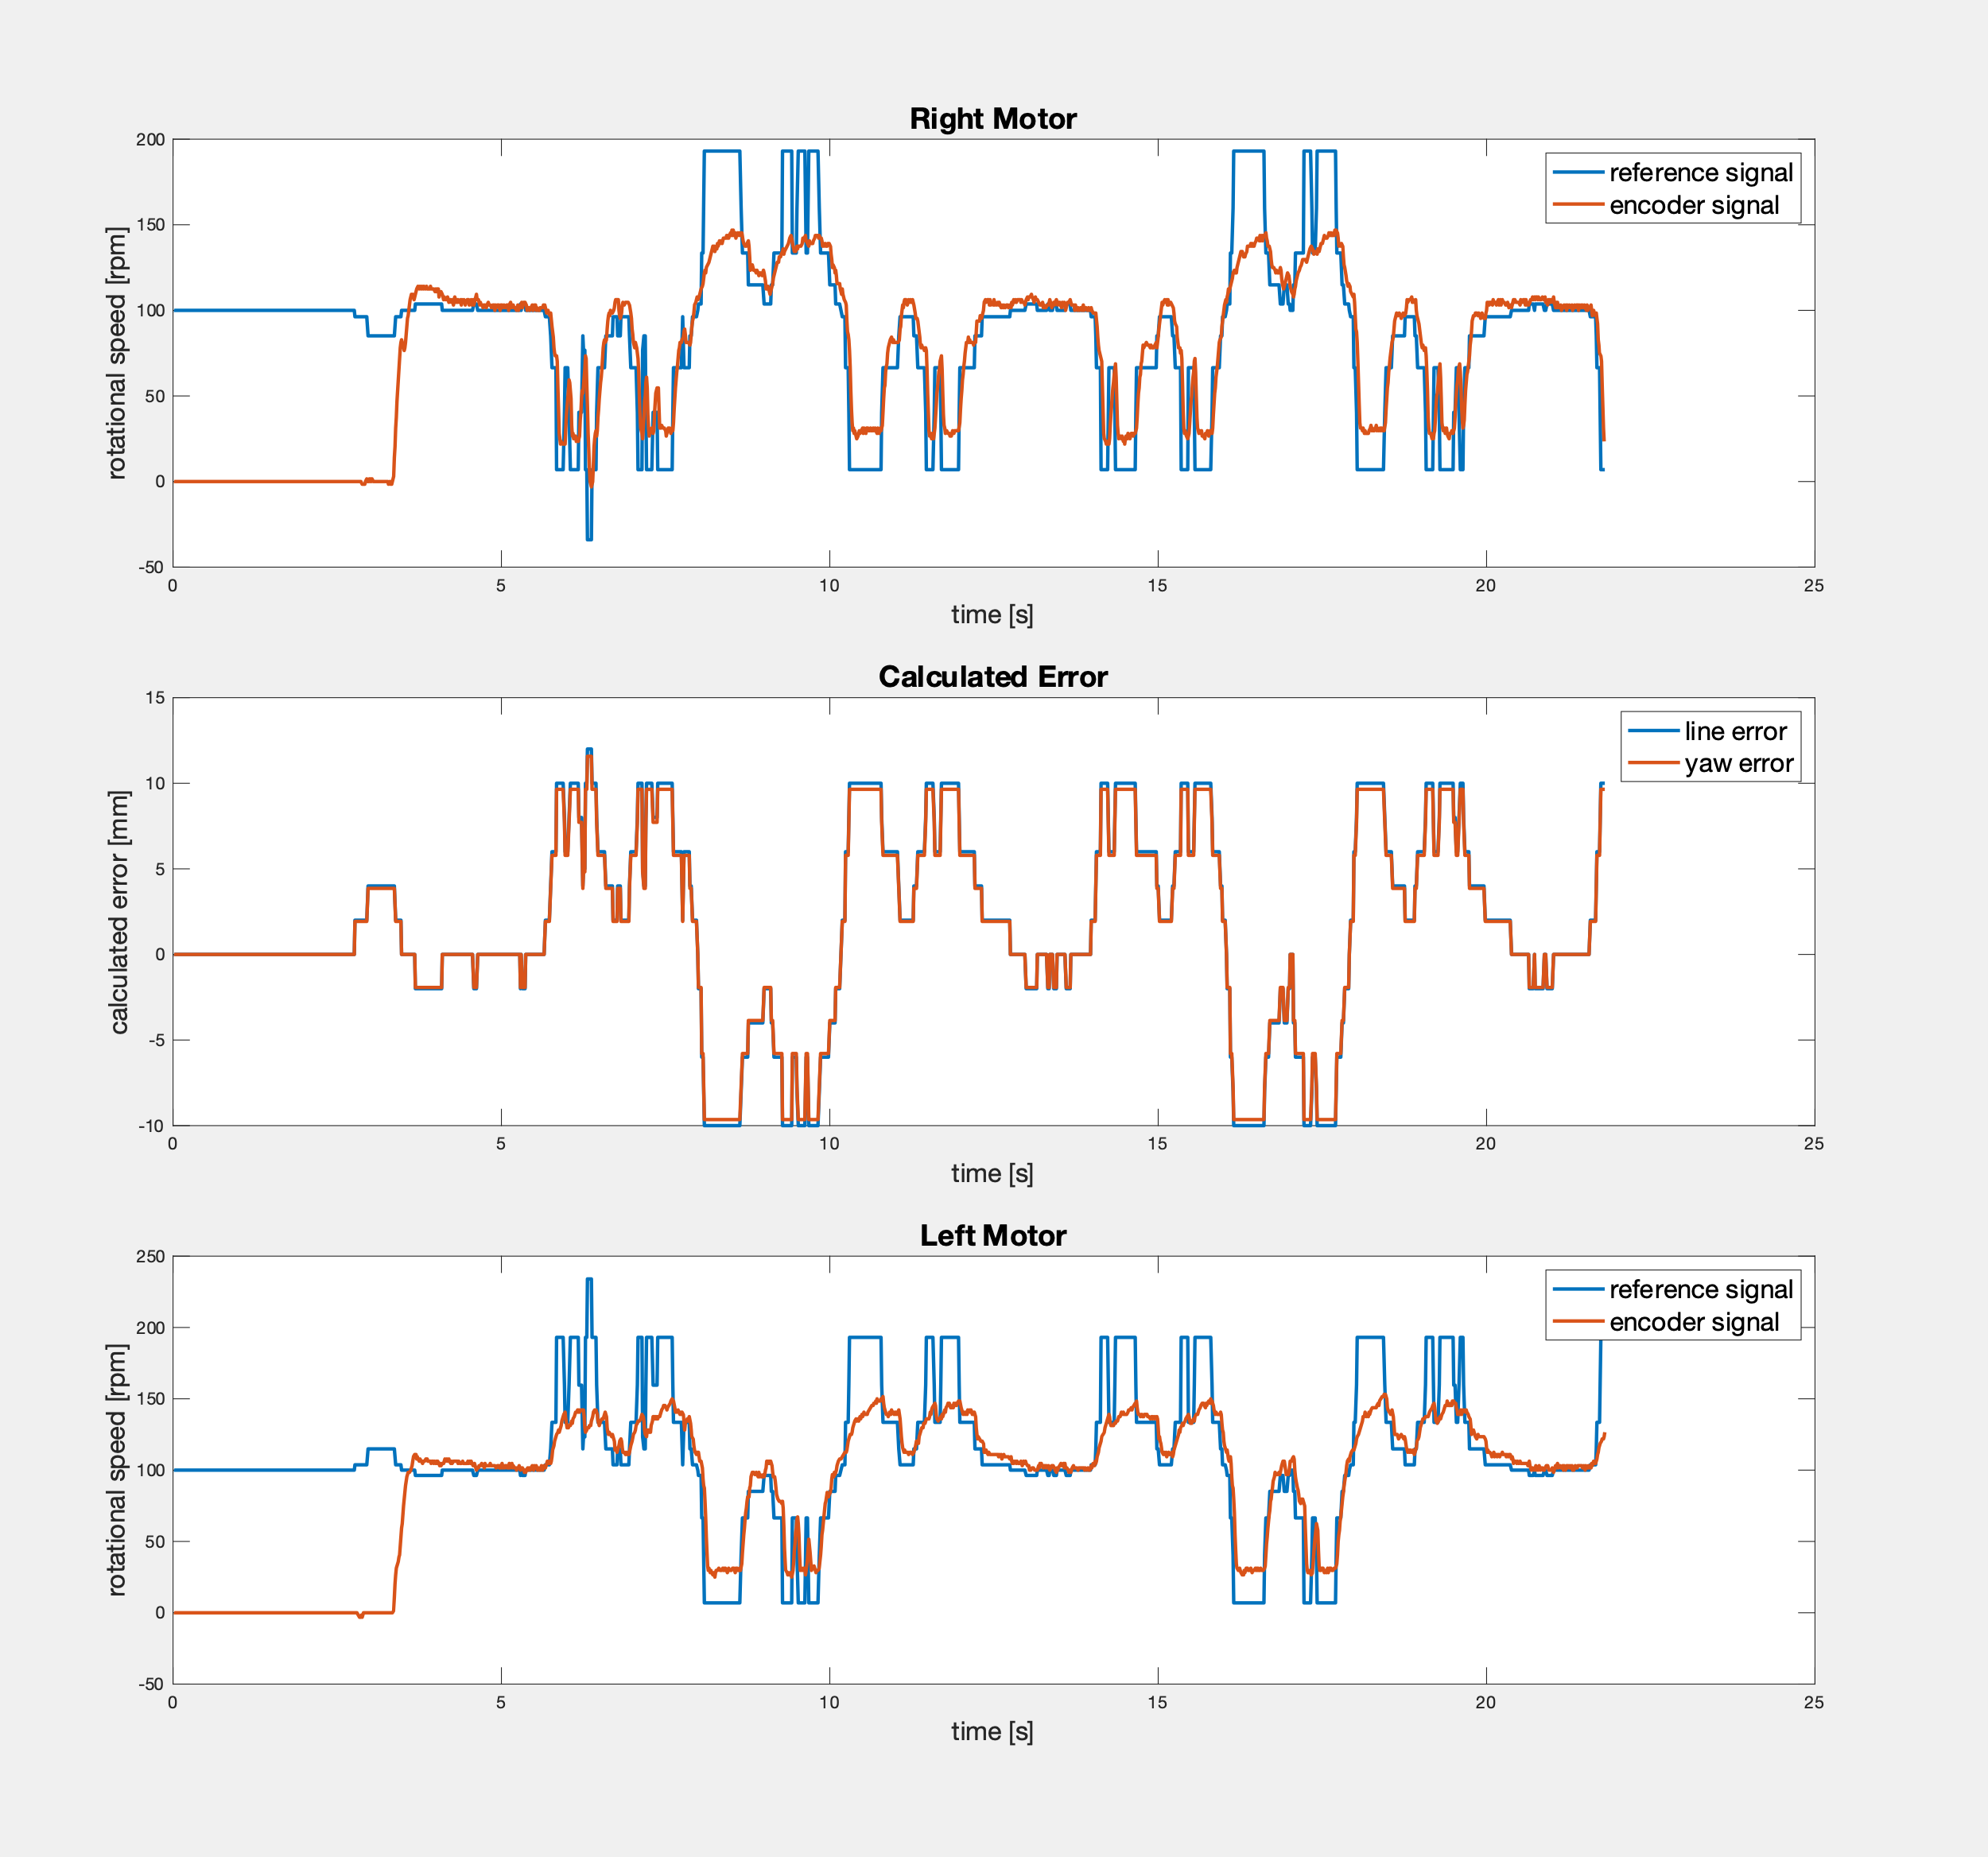
LAB4 - Results
Notes:
Achievement:
Fast and accurate tracking of the reference
Note worthy:
Line error ≈ yaw error, geometry Robot
Problems:
Reference set to high, limitation motors
Improvements:
Limiting reference to motor capability

